Slide 1
LSM MGT1022 Project Review 1
TEAM MENDIT
Here we will explain our entire work in crisp from the beginning…..

Slide 2
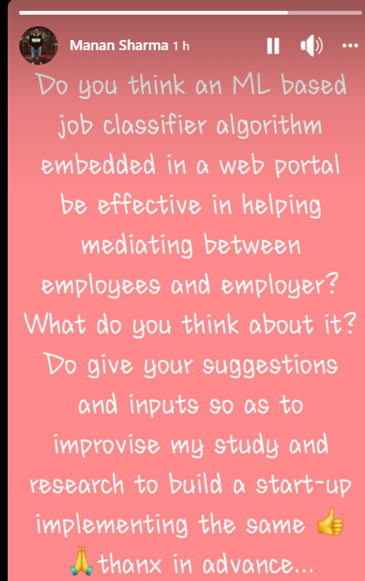
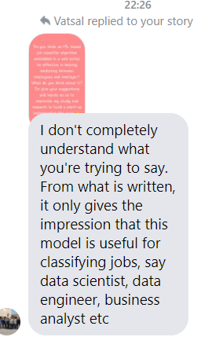
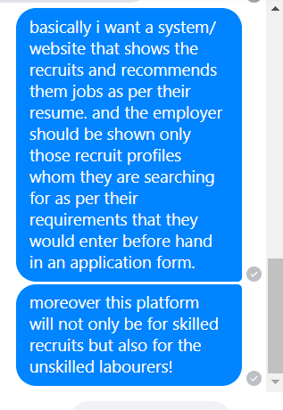
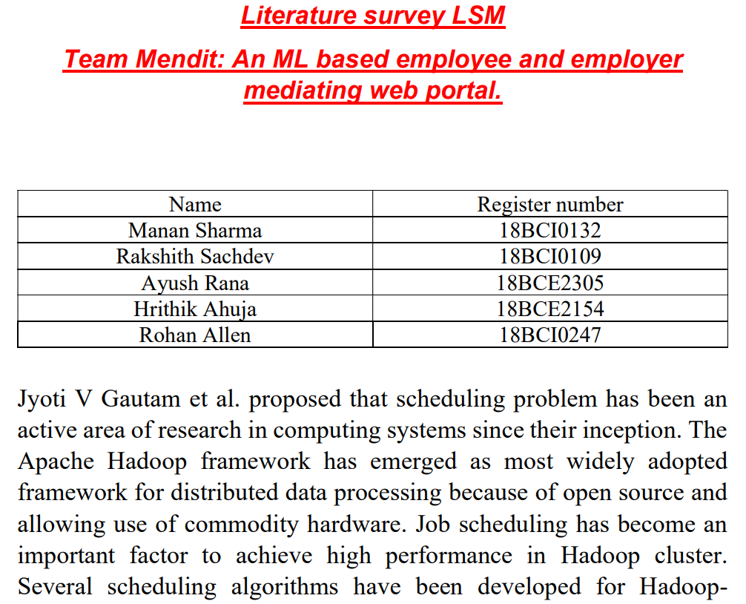
First task- Literature survey
We reviewed and referred 18 research as well as journal papers, analysed them for their accomplishments, future works and gaps were identified. Then we noted down their gaps and the competitions that we have and their features so as to improvise them.

Slide 3
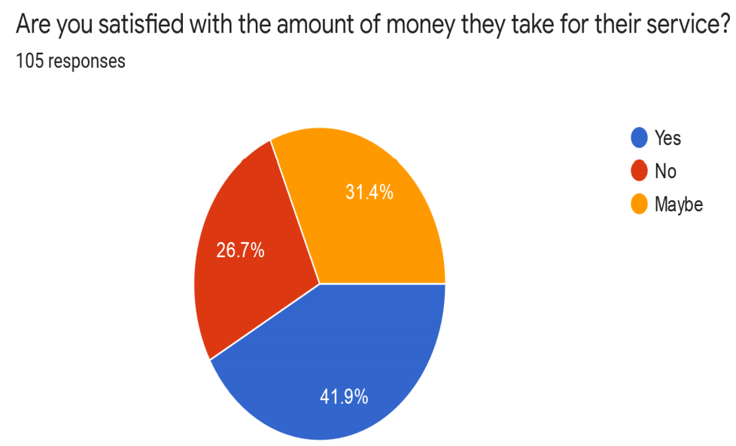
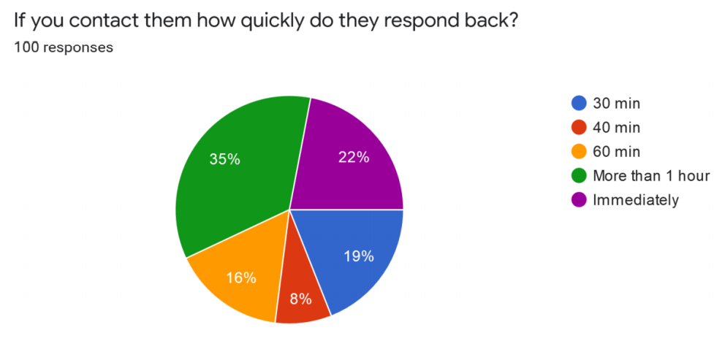
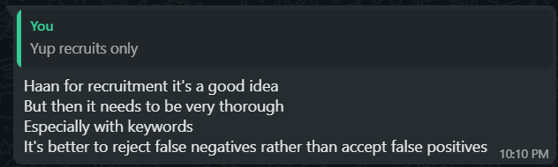
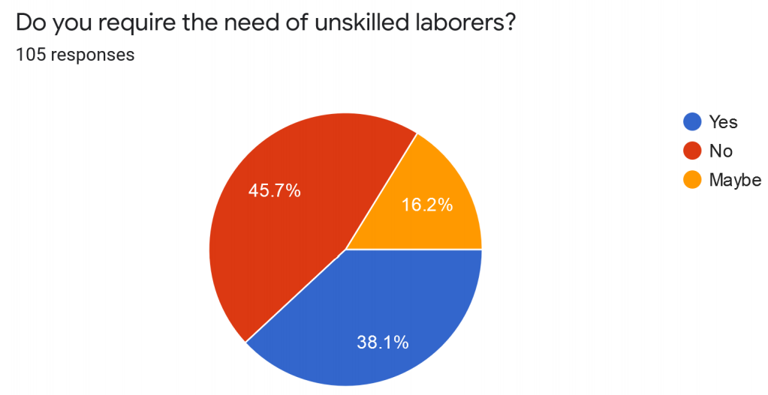
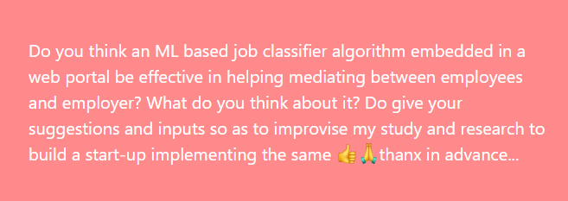
We did a market survey including interviews and opinion gathering from our friends, relatives and most importantly our parents
We gathered their opinions and criticisms as well we talked about the criticisms with our parents and found solutions to them in our recent meeting.
We planned a special feature (immersive readers) in the GUI of our web portal and a security feature for web application security.

Slide 4
Business plan to be followed by the team MENDIT
Key partners: skilled workers, payment processors and investors. Key stakeholders: include skilled and unskilled workers and employers or vendors.
Key activities: Marketing, product development, hiring, management, risk assessment and customer support.
Unique selling propositions: Security feature, cash and cashless transactions, visually disabled user friendly, time and cost optimisation.
Customer relations and channels: Social media including google, Facebook and WhatsApp, feedback and customer help system, web portal.
Workers: Unskilled and skilled workers who are unemployed.
Key resources: Web based M.L. embedded platform, security feature for web security, skilled employees.

Slide 5
Cost estimation by team Mendit for the online portal for mediating employees and employers…

Slide 6
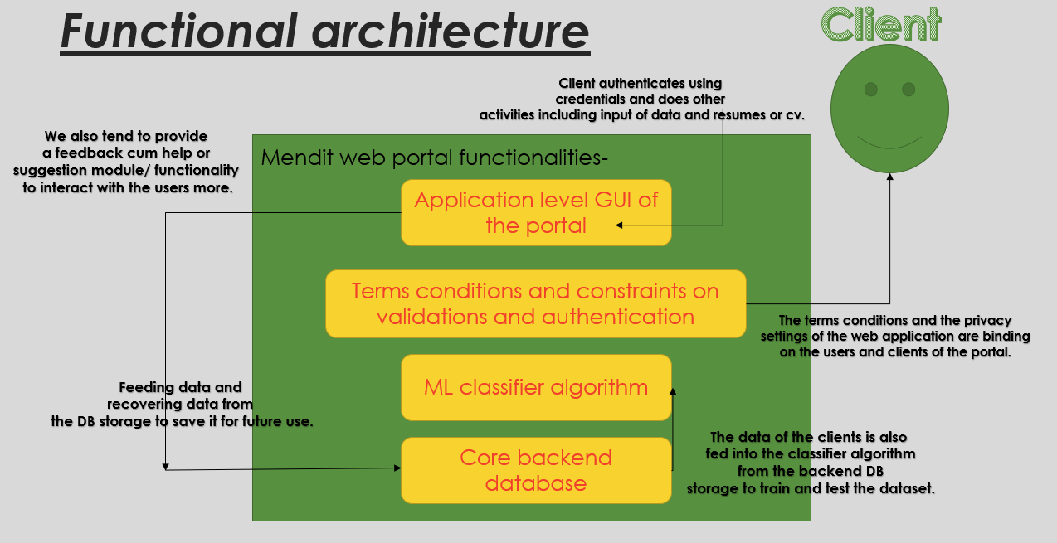
Functional design of our online portal Mendit

Slide 7
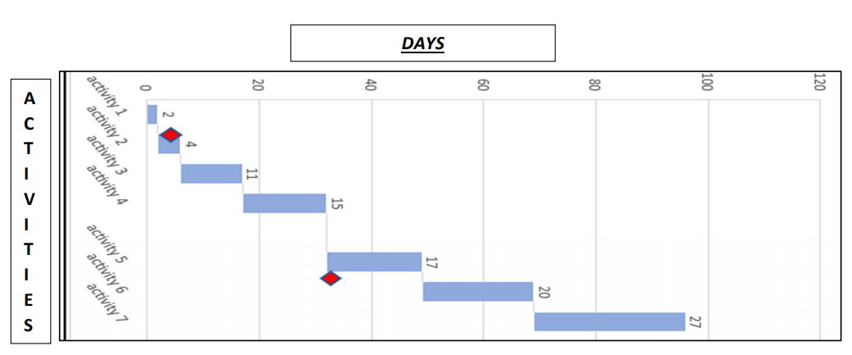
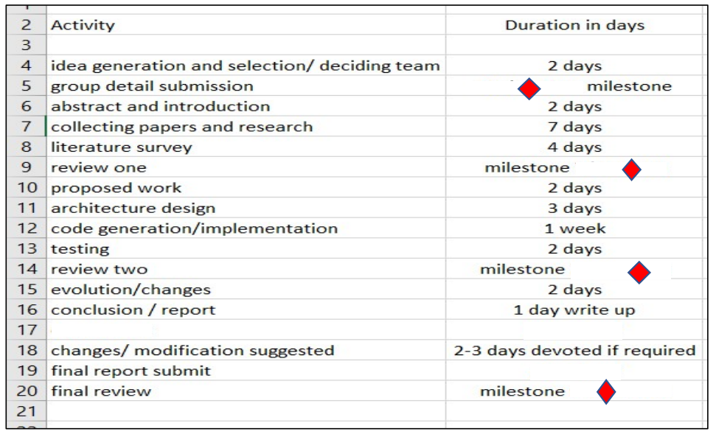
Road map to be followed for the completion of the Startup process and deployment:
Completion of analysis and requirement understanding.
Analysing requirements and requirement specification designing and risk analysis.
. Coding and implementation design and GUI and backend
Embedding ML algorithm and testing/ reviewing.
Legal matters and terms and conditions defined.
Build a Help and feedback system and maintenance

Slide 8
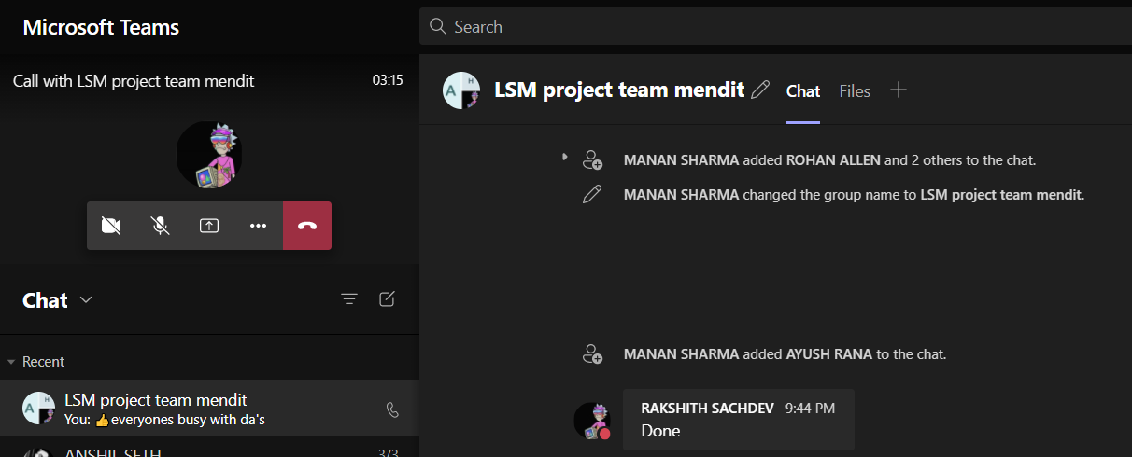
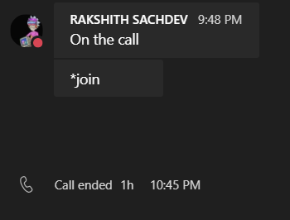
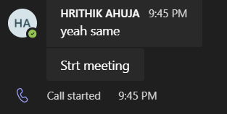
MOM’s
1. Discussion and distribution of research papers for the survey of the literature.
Distribution of the work and papers 4-5 paper each person.
Mom 2:
Discussion and selection of questions for the review and surveys.
Making forms and google survey and planning to get responses for the same.
Observation and collection of functional requirements of our system.
Business model decisions
Cost estimation factors decided and noted down
Interviews and responses from parents and friends noted doen and documented to be followed while working.
Survey and marketing analysis done efficiently to extract the requirements.
MOM 4:
Road map decide and detailed road map created for the future and discussion on the inputs given by family members and parents.

